Slide 1
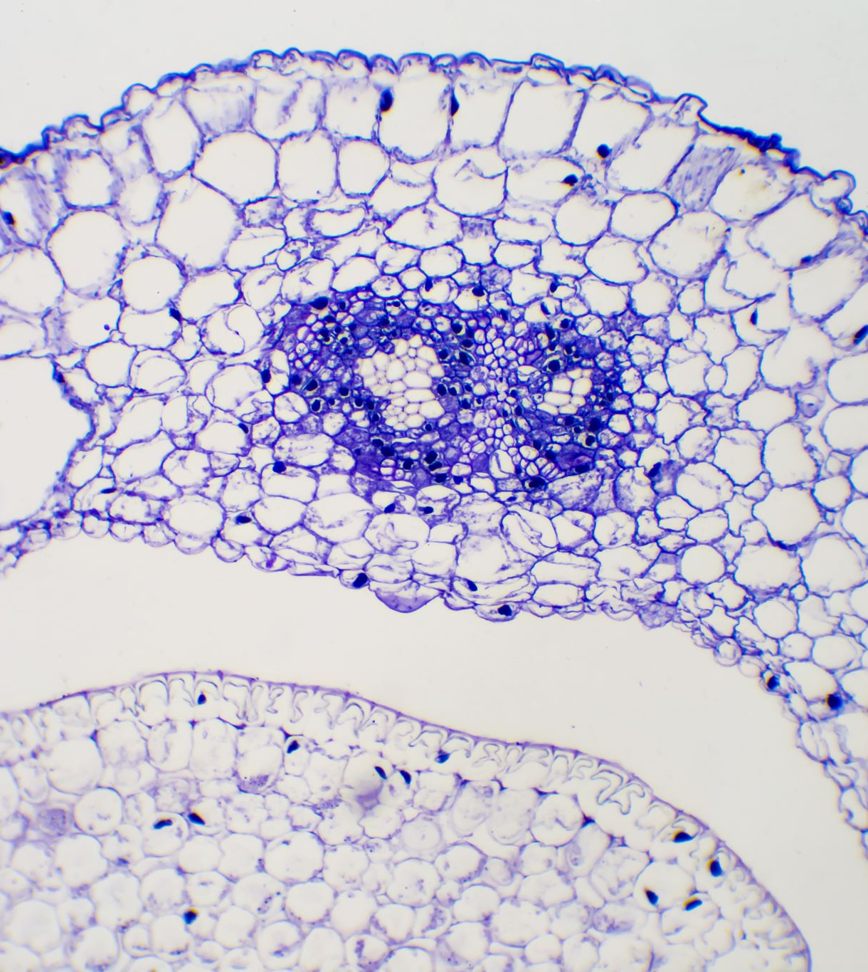
Tableau Project
Topic : Tuberculosis Burden by country
Ikenna Odinye

Slide 2

Project Outlines
Project goals/objectives
Processes
Results
Challenges
Future goals

Slide 3

Project goals
To enhance capacity on visualizing with Tableau
To identify the most significant and impactful findings in the TB burden dataset

Slide 4

Project objectives
Look for pattern that are consistent across multiple visualization, forecast, and cluster results
1
Identify regions/countries or time periods with high TB prevalence, mortality, or case detection rates.
2
Identify regions with notable improvements or success stories in fight against TB.
3

Slide 5

Processes/steps
Step 1
Step 1
Connect to TB burden dataset, identify data types and create 5 different visualization to understand the data better
Step 4
Step 4
Identify important features out of the 47 in the dataset, state why they are important and define a question.
Step 5
Step 5
Show maps, date time visuals, and analytical visuals( forecasting & clustering). Find patterns and create dashboard.

Slide 6
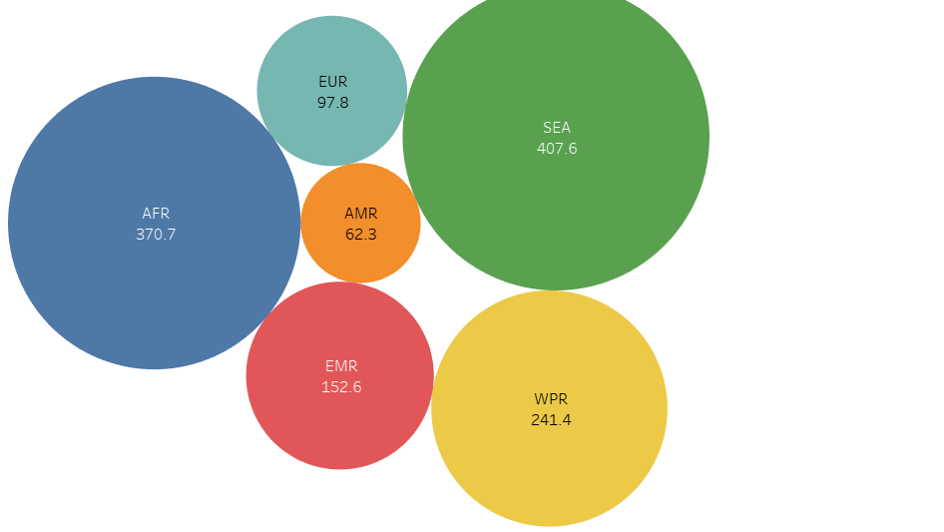
1st visual

Slide 7
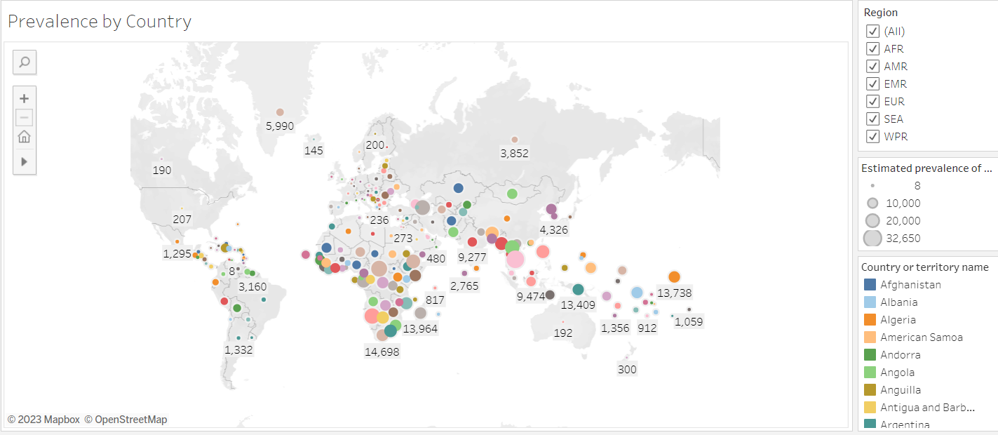
2nd Visual

Slide 8
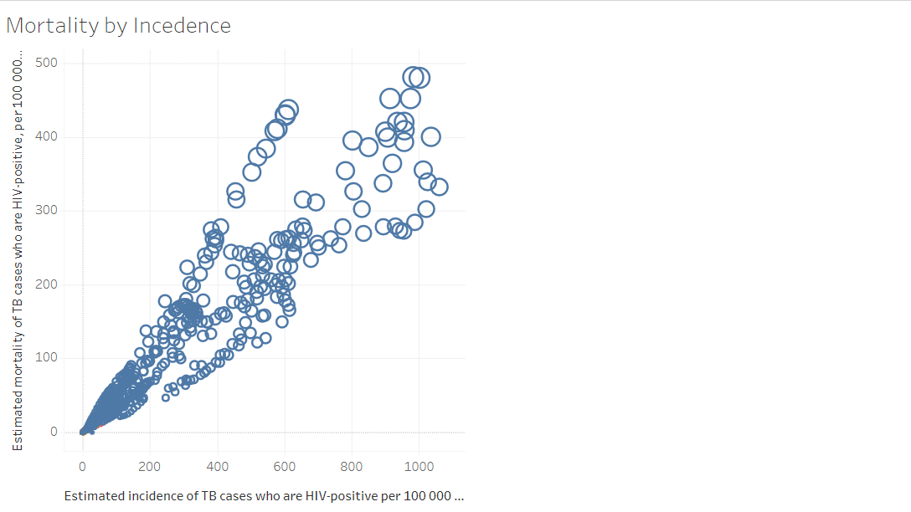
3rd Visuals

Slide 9
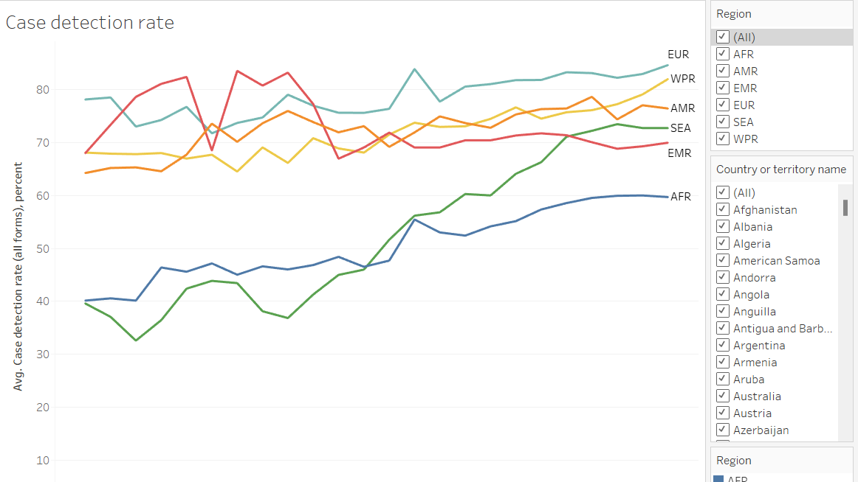
4th Visuals

Slide 10
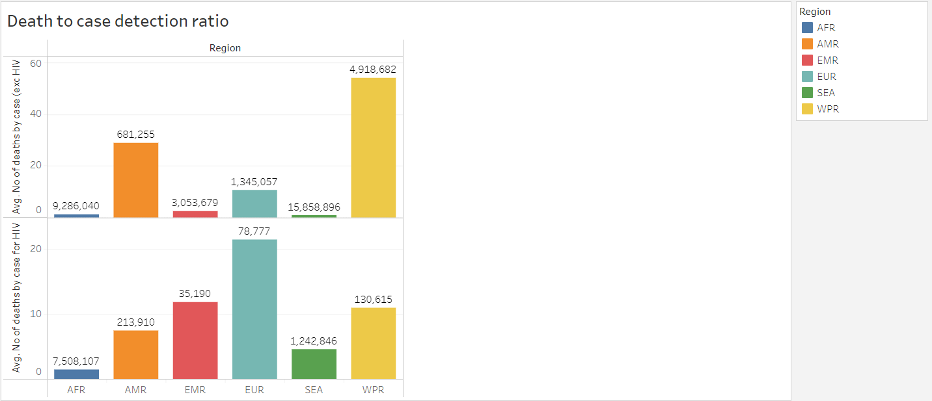
5th visual

Slide 11
Step 4 results
The important features identified and why :
Estimated prevalence of TB (all forms) per 100,000 people: To ascertain how TB prevalence varies across countries overtime
Case detection rate (all forms) percent: Establish relationship between case delectation and TB death burden
Estimated number of deaths from TB exclusive and inclusive of HIV: Impact of HIV/AIDS as co-morbidity
Estimated mortality of TB cases (all forms) exclusive and inclusive of HIV per 100,000 people: Still on TB HIV/AIDS impact
Estimated incidence all forms per 100,000: Emergence of new cases across regions/countries
Methods to derive prevalence & mortality: Data validity
Questions: (1)What are the factors influencing high prevalence in certain countries and regions.
(2) What are the effectiveness of different detection methods
(3) What is the impact of TB/HIV as co-morbidity on mortality rate
(4) What is the effect of population on TB prevalence in countries/region

Slide 12

Step 5 – 8 results

Slide 13
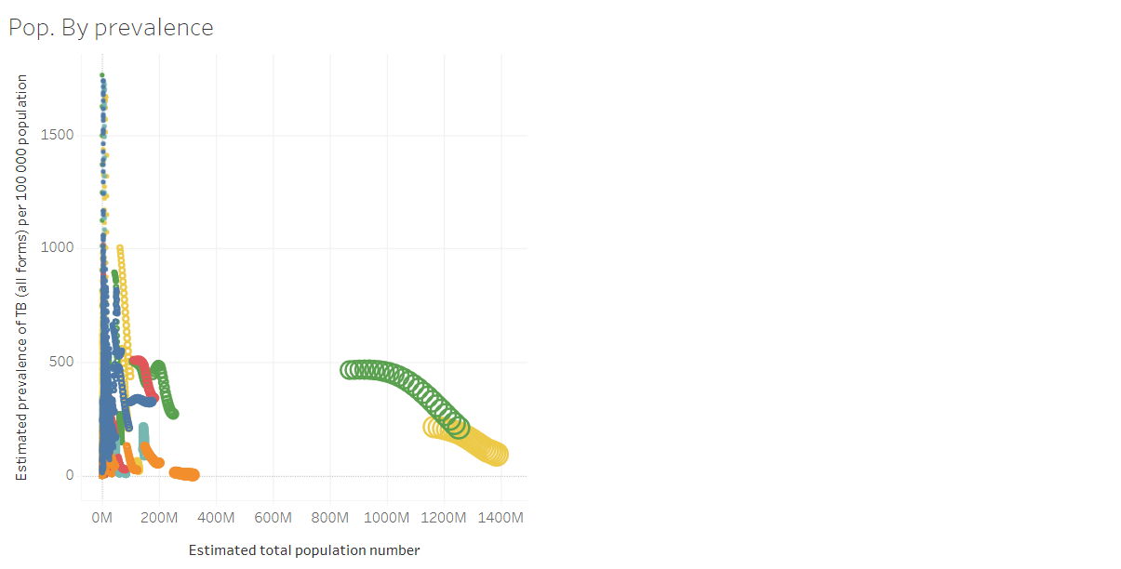
Population by prevalence

Slide 14
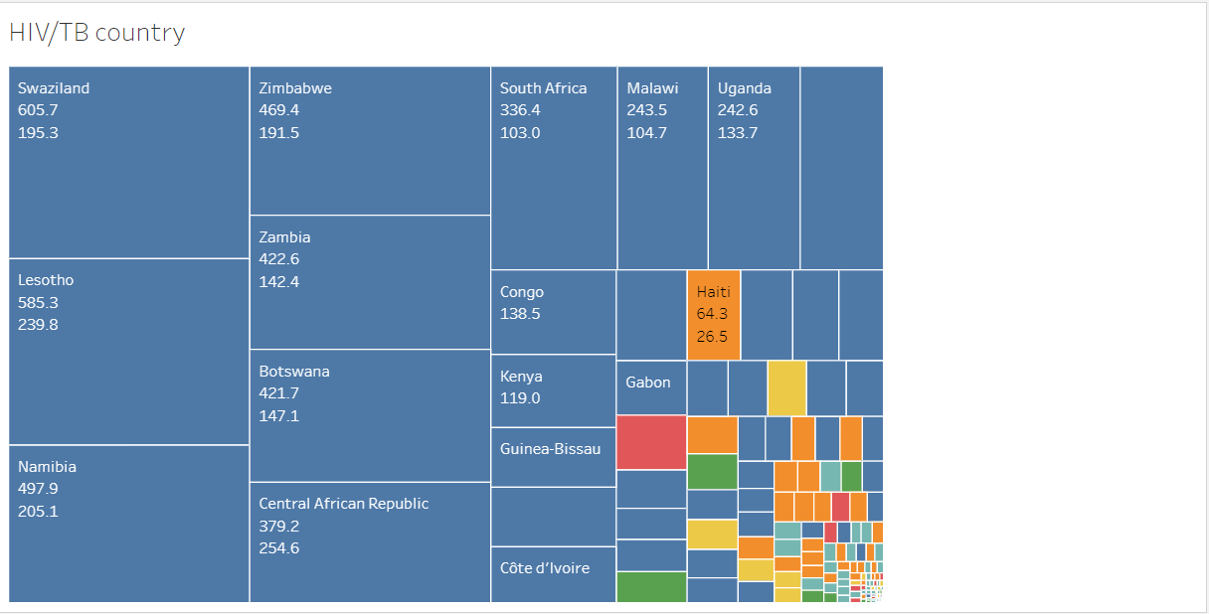
TB HIV/AIDS burden

Slide 15
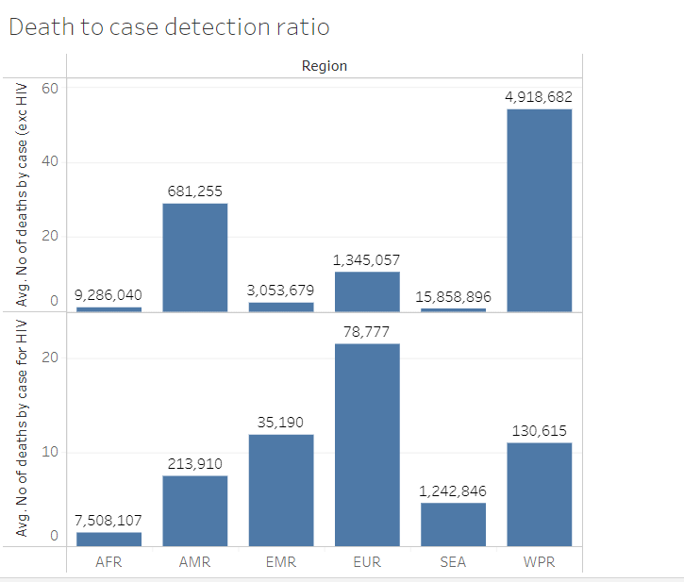
Death to case detection ratio

Slide 16
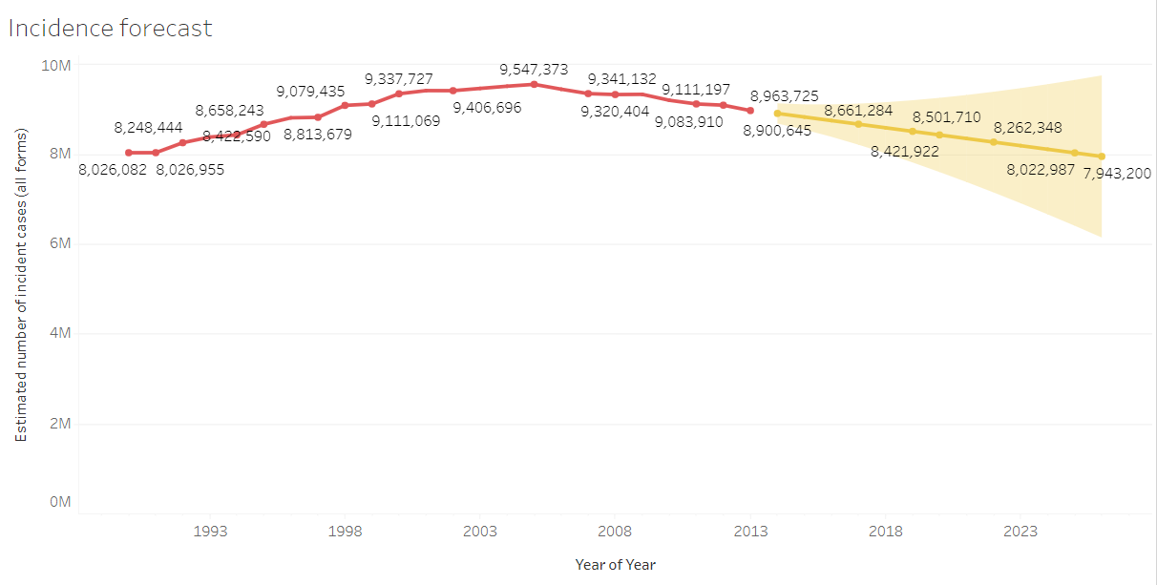
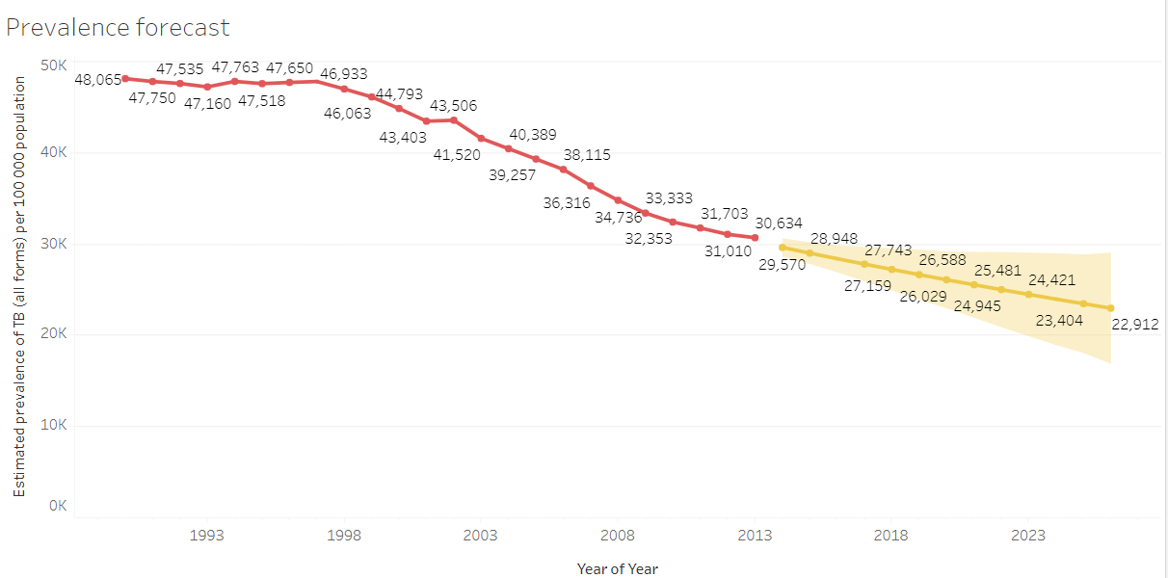
Prevalence & Incidence forecast

Slide 17
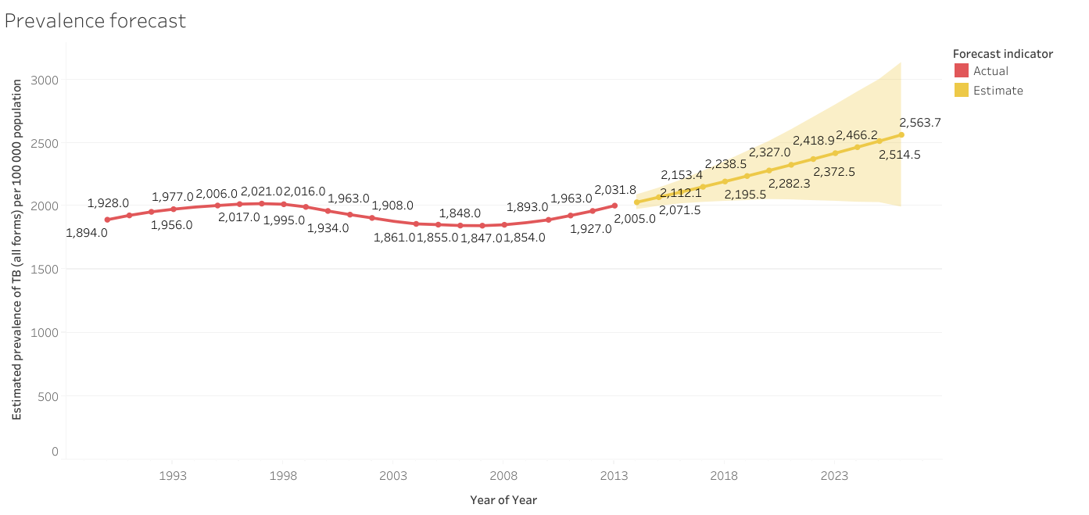
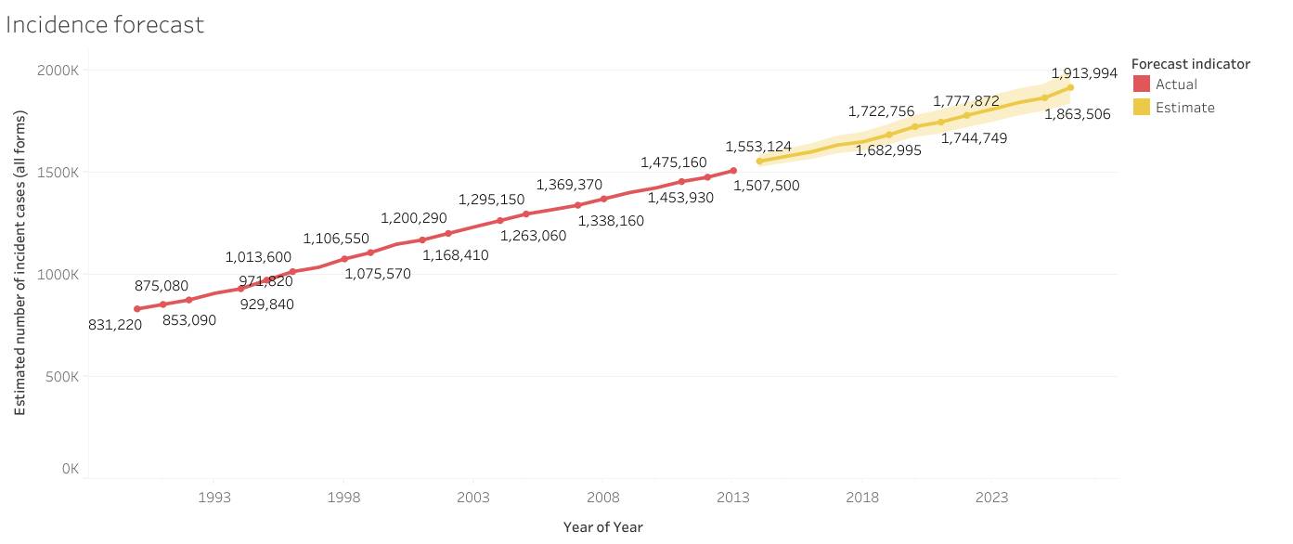
Countries with high prevalence
Region | Country
AFR | Nigeria
AMR | Venezuela
SEA | Sri Lanka
EMR | Afghanistan

Slide 18
Inputs for Clustering
Variables: | Sum of Estimated prevalence of TB (all forms) per 100 000 population
 | Sum of Case detection rate (all forms), percent
 | Sum of Estimated mortality of TB cases (all forms, excluding HIV) per 100 000 population
Level of Detail: | Not Aggregated
Scaling: | Normalized
Summary Diagnostics
Number of Clusters: | 2
Number of Points: | 4671
Between-group Sum of Squares: | 116.42
Within-group Sum of Squares: | 79.967
Total Sum of Squares: | 196.38

Slide 19
Centers
Clusters |  | Number of Items |  | Sum of Estimated prevalence of TB (all forms) per 100 000 population | Sum of Case detection rate (all forms), percent | Sum of Estimated mortality of TB cases (all forms, excluding HIV) per 100 000 population
Cluster 1 |  | 915 |  | 626.73 | 40.825 | 73.28
Cluster 2 |  | 3756 |  | 96.504 | 74.891 | 7.5898

Slide 20
Analysis of Variance:
 |  |  |  |  |  | Model |  |  | Error
Variable |  | F-statistic |  | p-value |  | Sum of Squares | DF |  | Sum of Squares | DF
Sum of Estimated prevalence of TB (all forms) per 100 000 population |  | 3039 |  | 0 |  | 66.7 | 1 |  | 102.5 | 4669
Sum of Estimated mortality of TB cases (all forms, excluding HIV) per 100 000 population |  | 3003 |  | 0 |  | 41.38 | 1 |  | 64.34 | 4669
Sum of Case detection rate (all forms), percent |  | 1316 |  | 0 |  | 8.338 | 1 |  | 29.57 | 4669

Slide 21
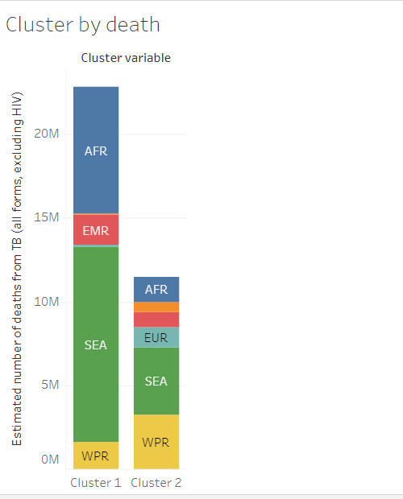
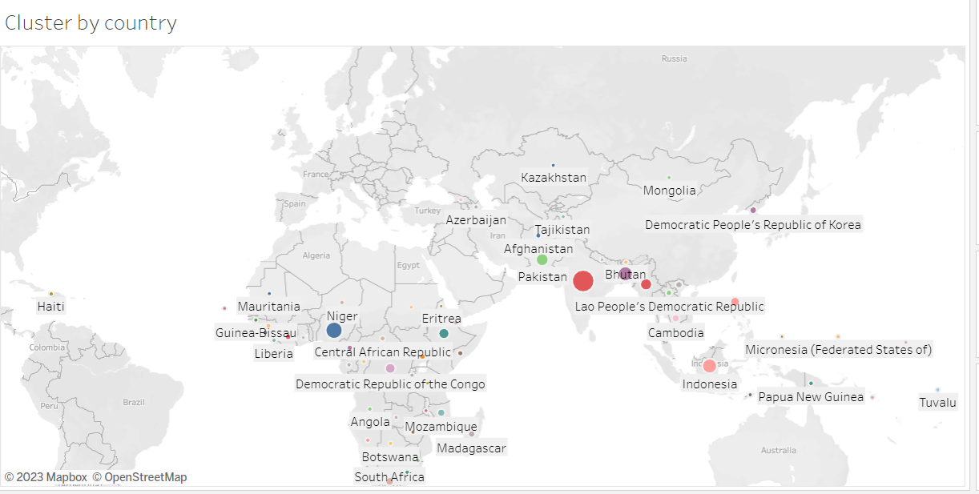
Cluster 1 Countries

Slide 22
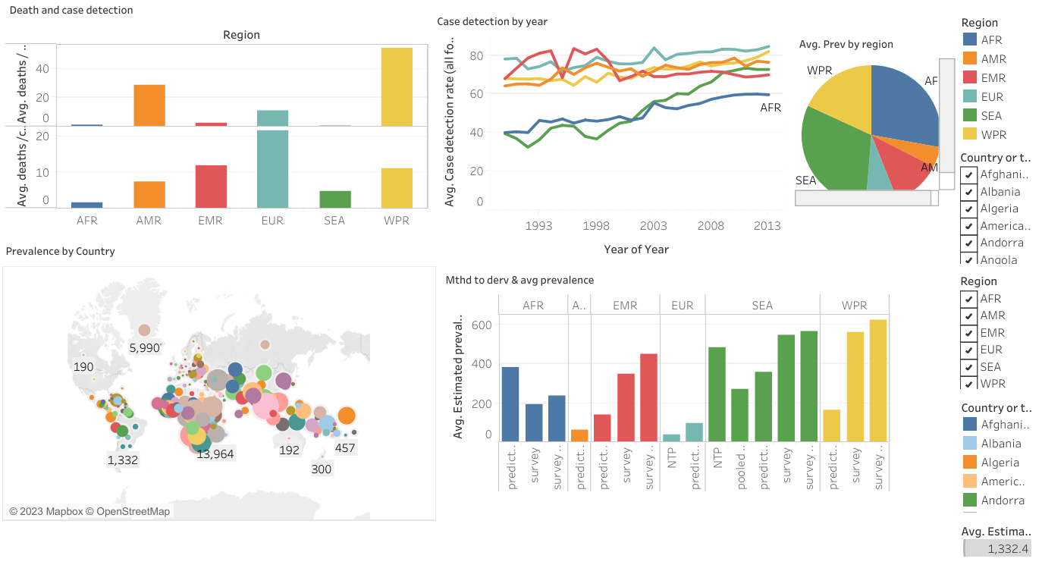

Slide 23
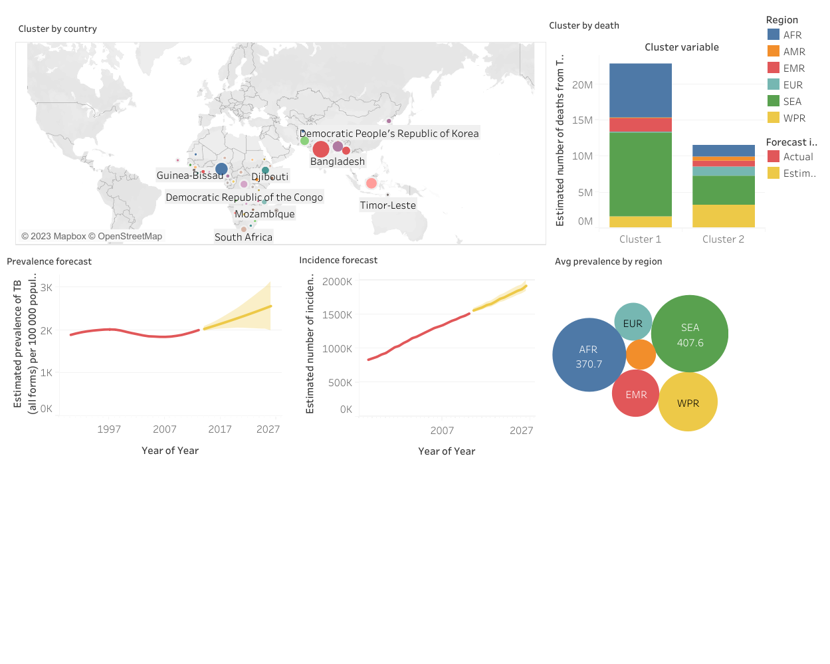

Slide 24
Analysis of Variance:
 |  |  |  |  |  | Model |  |  | Error
Variable |  | F-statistic |  | p-value |  | Sum of Squares | DF |  | Sum of Squares | DF
Sum of Estimated prevalence of TB (all forms) per 100 000 population |  | 3039 |  | 0 |  | 66.7 | 1 |  | 102.5 | 4669
Sum of Estimated mortality of TB cases (all forms, excluding HIV) per 100 000 population |  | 3003 |  | 0 |  | 41.38 | 1 |  | 64.34 | 4669
Sum of Case detection rate (all forms), percent |  | 1316 |  | 0 |  | 8.338 | 1 |  | 29.57 | 4669

Slide 25
Findings
By calculating the ratio of case detection to estimated number of deaths per 100,000 people from TB, I gained insights that effectiveness of TB early case finding has potential impact in reducing mortality. And this can be a KPI for how successful NTPs and Healthcare systems are, in fight against TB burden in respective countries.
For example, difference in case detection to death ratio between Africa (1.20) and America (28.98), despite higher deaths in Africa, suggests potential disparities in TB case detection and reporting between the two regions. Some factors that may be contributing to these are:
1) Variations in healthcare systems e.g. accessibility and quality of service
2) Diagnostic capacity
3) Under reporting and data quality

Slide 26
Challenges
Presenting my findings in clear concise manner.
Limited time to study dashboard creation.

Slide 27

Future Goal
Need to build my capacity on compelling story-telling in other to paint a good picture of my findings.

Slide 28

Thank you!

